Slide 1
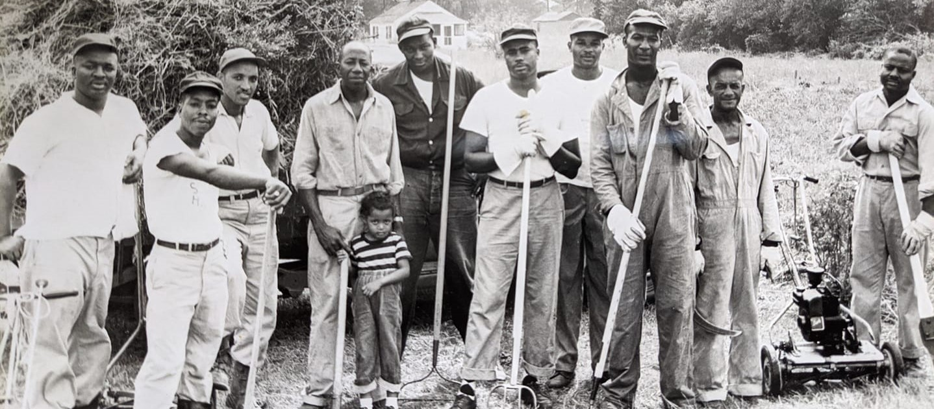
History through Family
Seaford
Historical
Society
The Seaford Historical Society presents:
The African-American Experience in Seaford, Delaware
Notes:
This photograph shows many local business owners who volunteered their time to maintain lots and open spaces in East Seaford.
NEED MORE ABOUT THIS PHOTO.

Slide 2
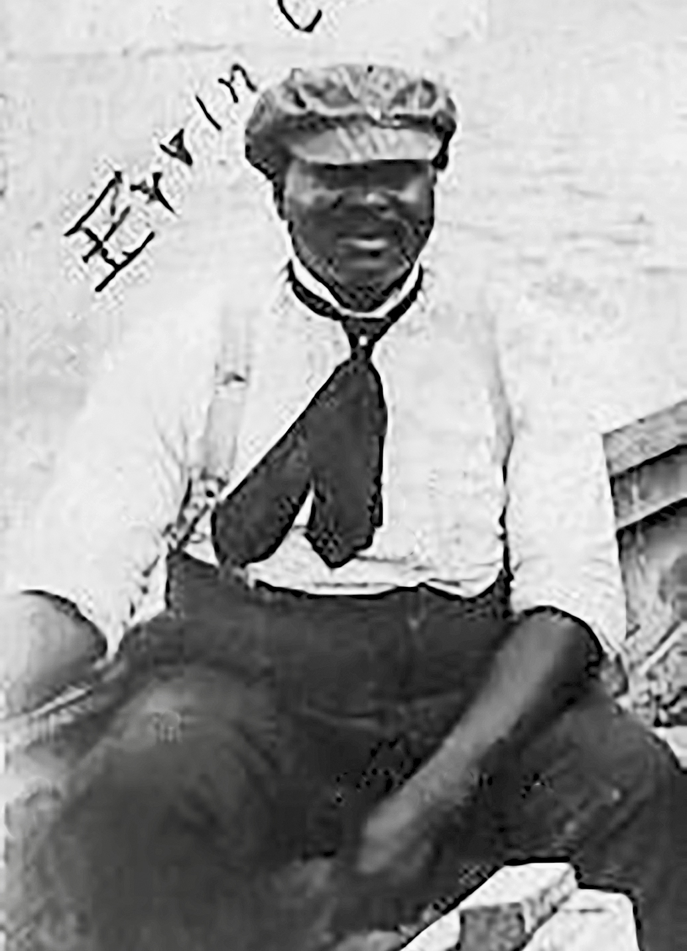
History Through Family
Seaford
Historical
Society
The Seaford Museum
May – September 2021
Grand Opening Ceremony
June 19th
Notes:
The result is our new exhibt HISTORY THROUGH FAMILY, The African-American Experience in Seaford, Delaware…
That will be housed at the Seaford Museum from May through September 2021.
The photo is of Ervin Cannon taken sometime around 1890. This is a detail of a larger photo in which Mr. Cannon is the only black man on an excursion boat with several white men. It is possible that Mr. Cannon was a river pilot.

Slide 3
History Through Family
Seaford
Historical
Society
We endeavor to present a balanced view of local history
Good intentions can be limited by experience and culture
We want to tell the story of our community from a new perspective
Notes:
THE BOOK WITH JEFFERSON ON THE COVER WAS CHOSEN INTENTIONALLY.
As everyone from an under-represented community knows, history books are written with a point-of-view…
And while those presenting history may have the very best of intentions, their experiences and education limit their ability to tell the full story.
With this in mind, the Seaford Historical Society wants to start ASKING our community about its history, instead of just “telling” about it.

Slide 4
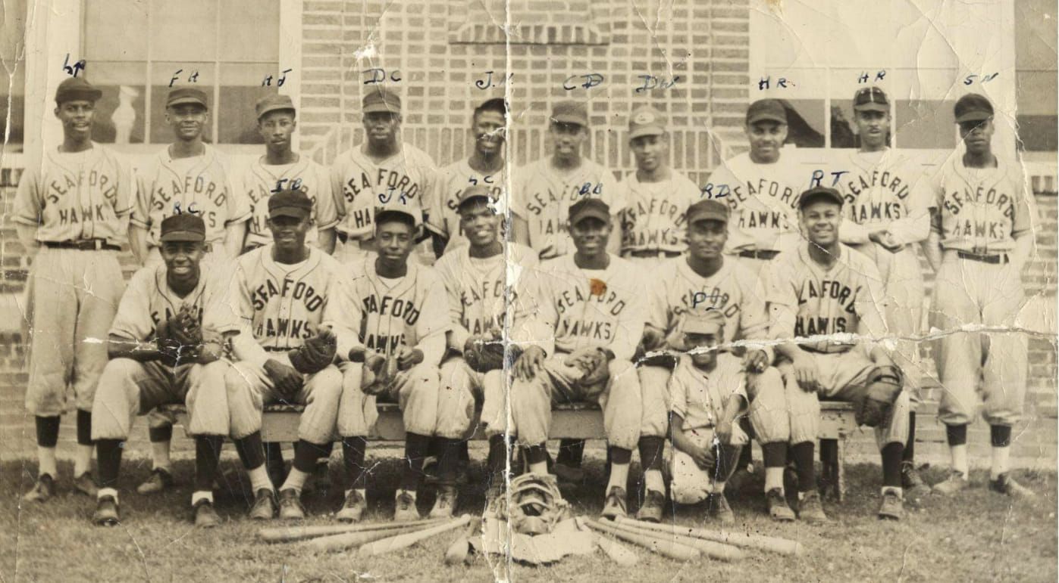
History Through Family
Seaford
Historical
Society
Community Curated
Everything in the exhibit comes from the people of our town.
BY OUR community FOR OUR community

Slide 5
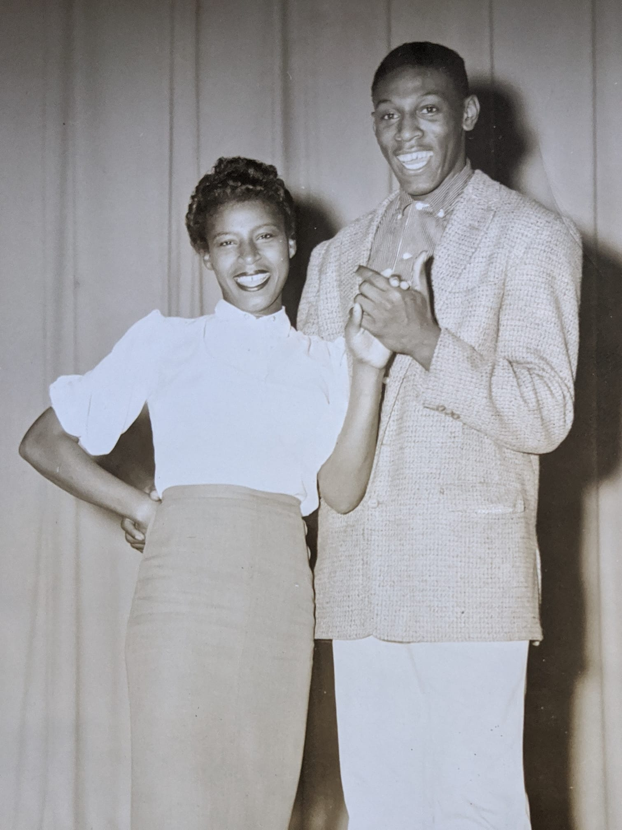
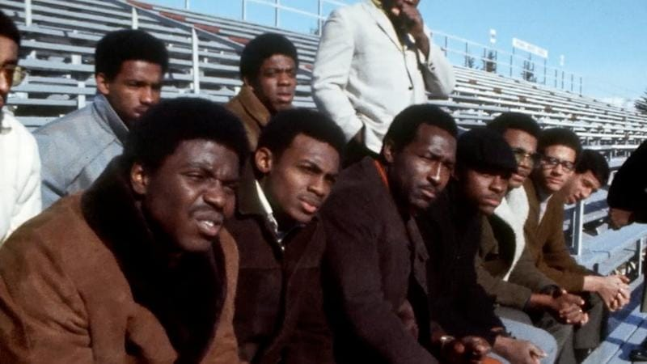
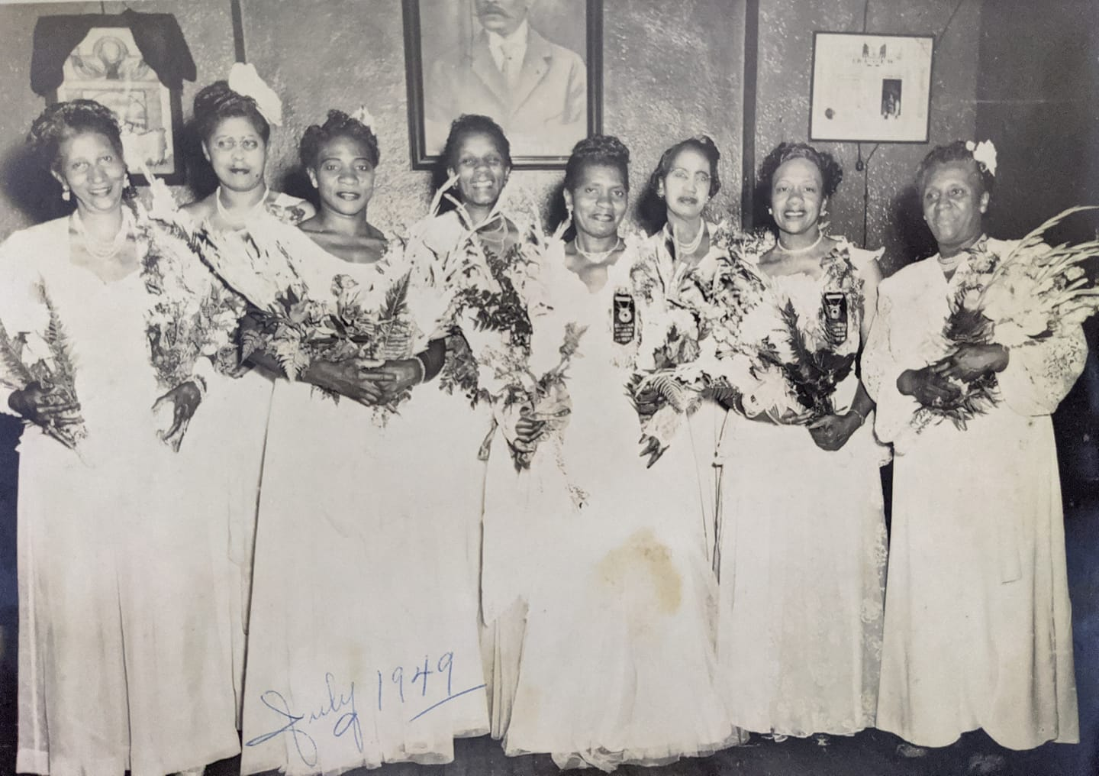
History Through Family
Seaford
Historical
Society
What we need
Photographs
People, Places, Events
Old and Not-so-old
Need to Tell a Story
Originals preferred
Securely stored and displayed
Notes:
DO WE KNOW THE STORIES BEHIND ANY OF THESE PHOTOS?

Slide 6
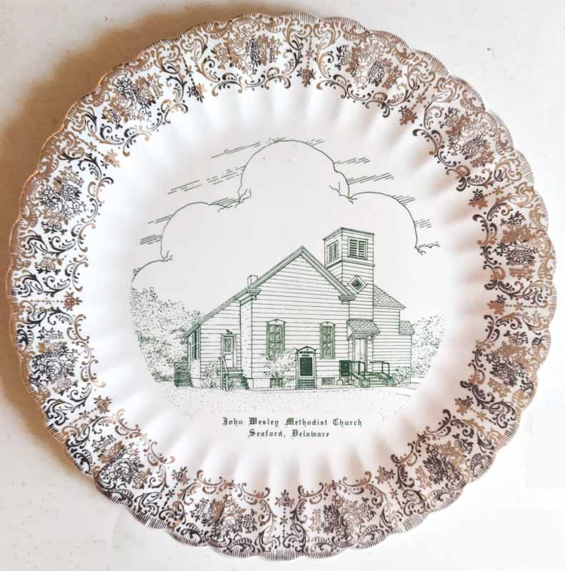
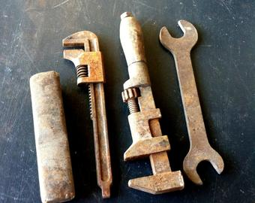
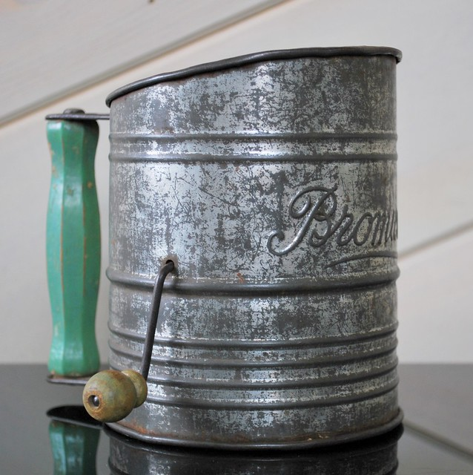
History Through Family
Seaford
Historical
Society
What we need
Artifacts
Precious or Ordinary
Don’t have to be Valuable.
Need to Tell a Story.
Displayed behind glass
Notes:
ONLY THE PHOTO OF MISS BLUE JAY IS TIED TO THE EXHIBIT; THE REST ARE STOCK PHOTOS. AS WE GET ARTIFACTS THESE CAN BE REPLACED WITH THE GENUINE ARTICLE.
WHAT IS THE MISS BLUE JAY STORY?

Slide 7
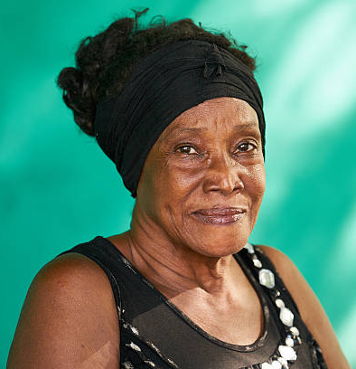
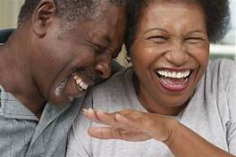
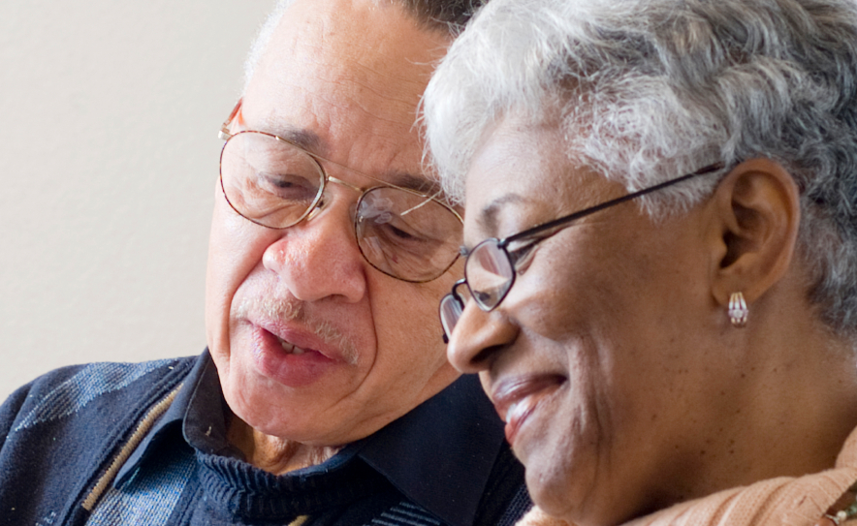
History Through Family
Seaford
Historical
Society
What we need
Stories
Recollections of People and Times Gone By
Poignant, Triumphant or Funny
Our website tells you how
Notes:
I’M CLOSE TO FINISHING A HOW-TO WORKSHEET ON DOING ORAL HISTORIES. I‘LL SHARE IT AS SOON AS IT’S READY FOR A PROOFREAD.
THESE ARE STOCK PHOTOS.

Slide 8
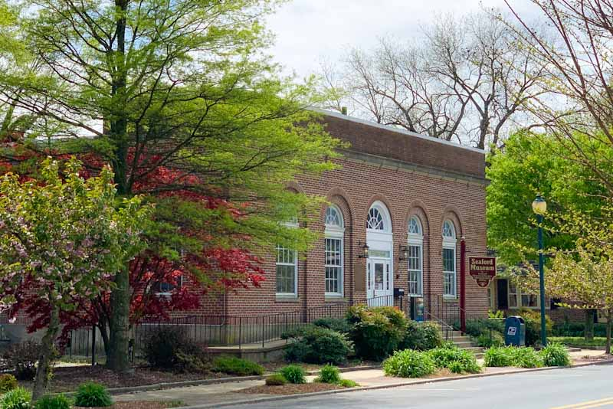
History Through Family
Seaford
Historical
Society
Seaford Historical Society
Coordination
Resources
Promotion
www.SeafordHistoricalSociety.com
Notes:
WE NEED A BETTER TERM FOR “QUALITY CONTROL”

Slide 9
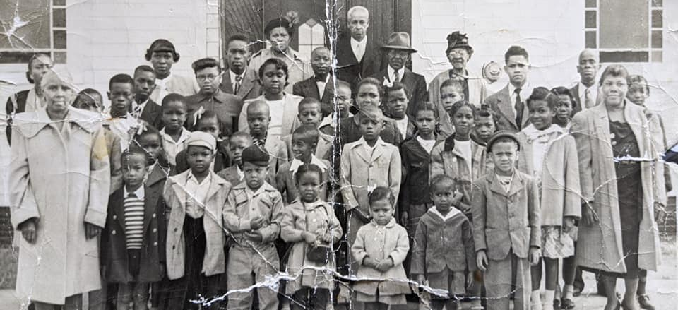
History Through Family
Seaford
Historical
Society
Community Involvement
Churches
Recruit Families to share their memories, photos, and artifacts
Promote community and youth involvement

Slide 10
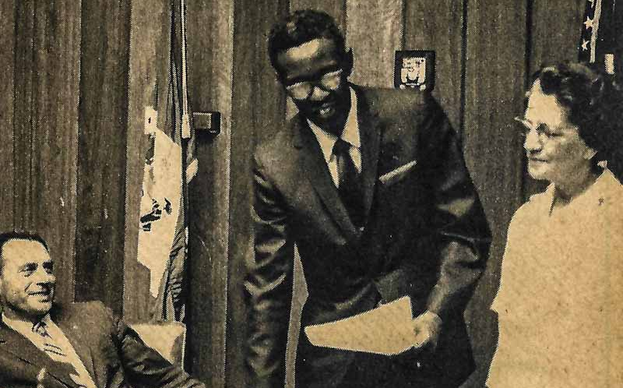
History Through Family
Seaford
Historical
Society
Community Involvement
Government &
Civic Groups
Access to records and artifacts
Financial Support
Promotion throughout community

Slide 11
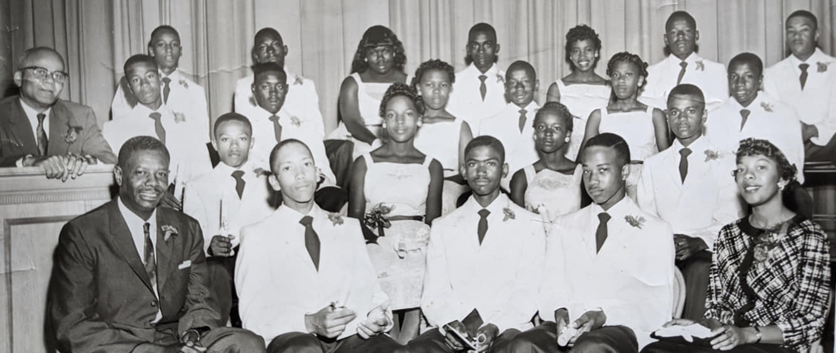
History Through Family
Seaford
Historical
Society
Community Involvement
Schools
Schools are where cultures come together
Best environment for dialog within our community

Slide 12
History Through Family
Seaford
Historical
Society
Community Involvement
Schools
Opportunities for Multi-Disciplinary projects
History, Language, Art, Media, Marketing, etc.

Slide 13
History Through Family
Seaford
Historical
Society
Community Involvement
Schools
History and Social Studies
Locate and evaluate artifacts and photographs
Collect and Present Oral Histories

Slide 14
History Through Family
Seaford
Historical
Society
Community Involvement
Schools
Language: The vehicle for expression
Written Word, Spoken Word, Music, and more
The affect of point-of-view on interpretation

Slide 15
History Through Family
Seaford
Historical
Society
Community Involvement
Schools
The Arts: Original Works for inclusion in exhibit
Express a spirit and vision of triumph
Opportunities for display and performance

Slide 16
History Through Family
Seaford
Historical
Society
Community Involvement
Schools
Media: Promote Public Interest and Attendance
Print and Video for promotion and display
Design audience-appropriate campaigns

Slide 17
History Through Family
Seaford
Historical
Society
Community Involvement
Schools
Get Students Involved
Adaptable to all grade levels and abilities
Perfect for Senior Projects!

Slide 18
History Through Family
Seaford
Historical
Society
Community Involvement
Schools
Schools can take the exhibit
from good to GREAT!

Slide 19
History Through Family
Seaford
Historical
Society
Community Involvement
Schools
Resources

Slide 20
History Through Family
Seaford
Historical
Society
www.SeafordHistoricalSociety.com

Slide 21
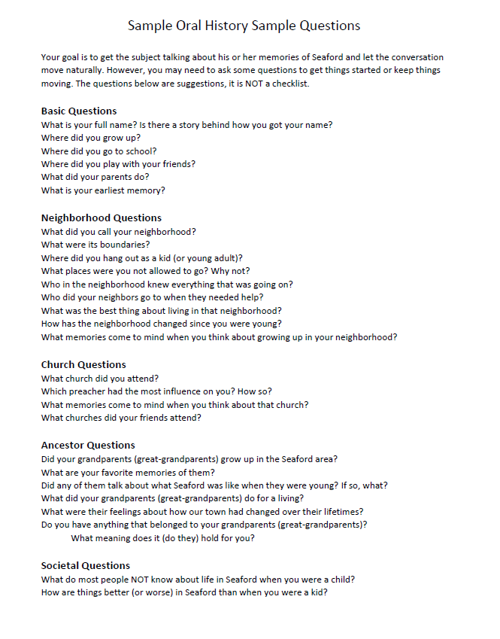
History Through Family
Seaford
Historical
Society

Slide 22
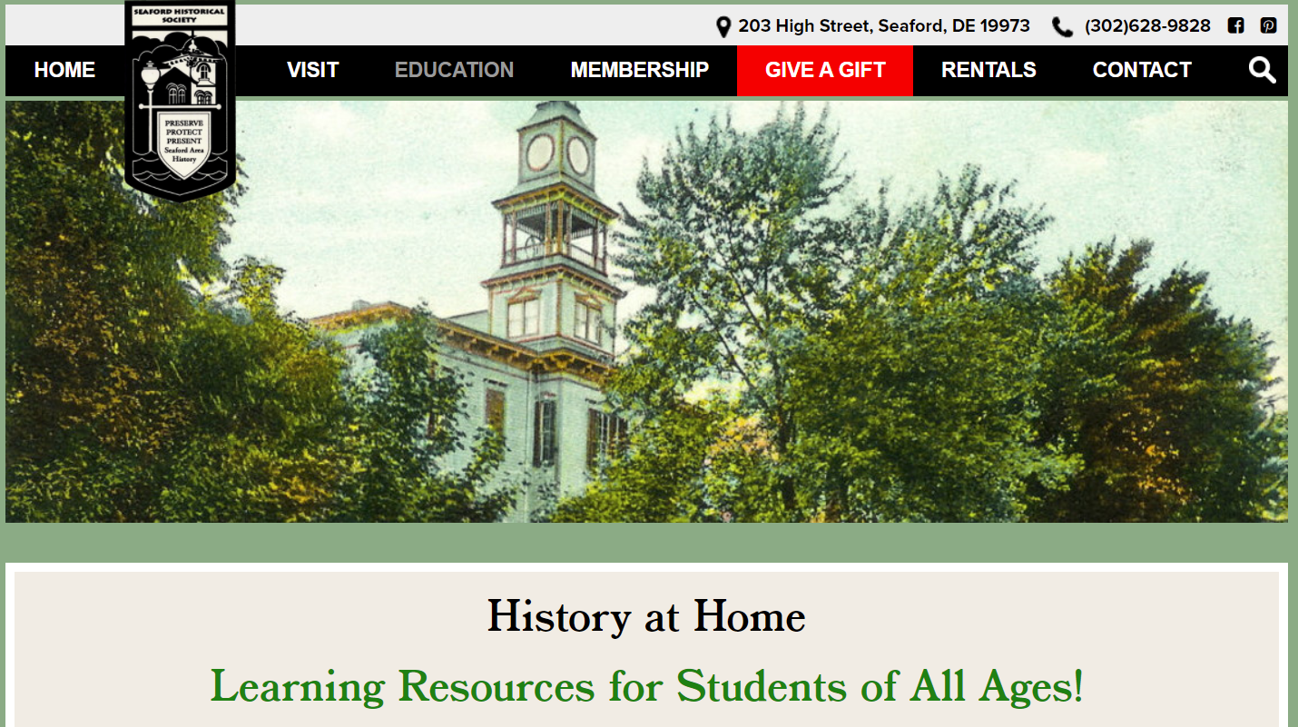
History Through Family
Seaford
Historical
Society
Other Learning Resources

Slide 23
History Through Family
Seaford
Historical
Society
It won’t happen without YOU!
Go to
SeafordHistoricalSociety.com
for resources and more information

